Slide 1

CS 533 INTRO TO DATA SCIENCE
Michael Ekstrand

Slide 2
VARIANCE AND SUM OF SQUARES

Slide 3

Learning Outcomes
Compute various sums-of-squares for a linear model
Understand what “explains 30% of the variance” means
Photo by Cris DiNoto on Unsplash

Slide 4

Sum of Squares
The total sum of squares:
$${SS}_{total}=\sum_{i}{{\left(y_{i}−\overline{y}\right)}^{2}}$$
This scales with variance:
$$Var\left(Y\right)=\frac{1}{n}\sum_{i}{{\left(y_{i}−\overline{y}\right)}^{2}}$$

Slide 5
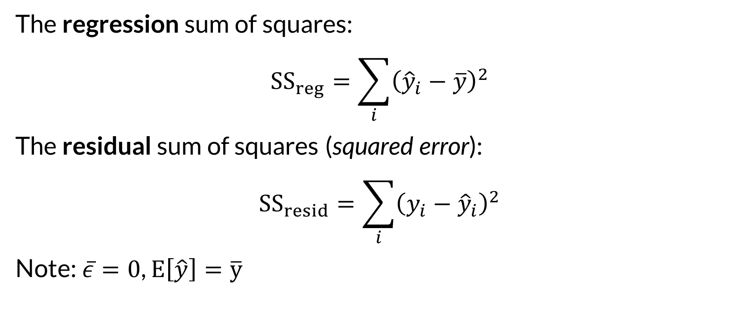
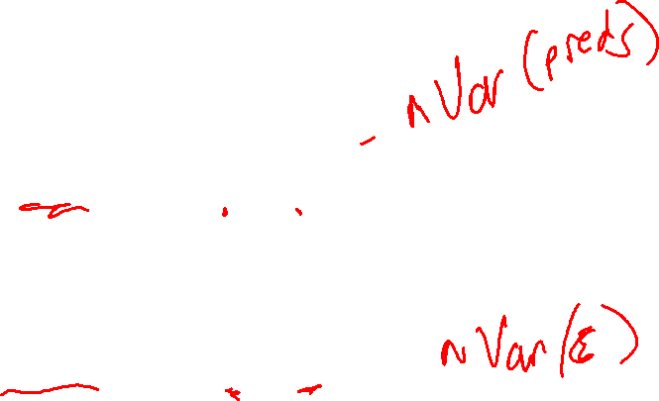
Other Sums of Squares
The regression sum of squares:
$${SS}_{reg}=\sum_{i}{{\left({\hat{y}}_{i}−\overline{y}\right)}^{2}}$$
The residual sum of squares (squared error):
$${SS}_{resid}=\sum_{i}{{\left(y_{i}−{\hat{y}}_{i}\right)}^{2}}$$
Note: $\overline{ε}=0$, $E\left[\hat{y}\right]=\overline{y}$

Slide 6
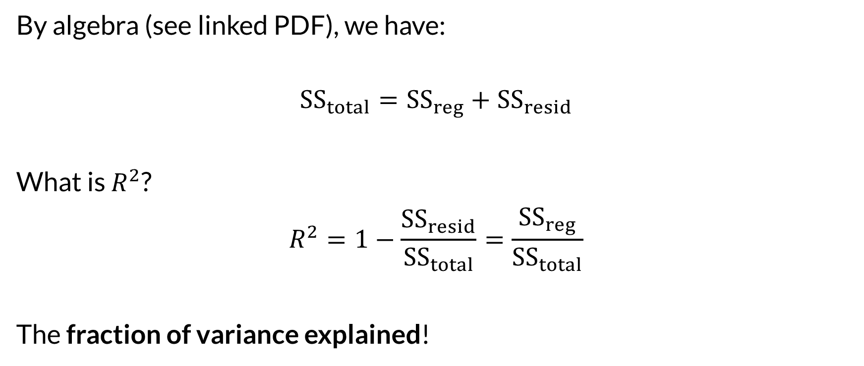
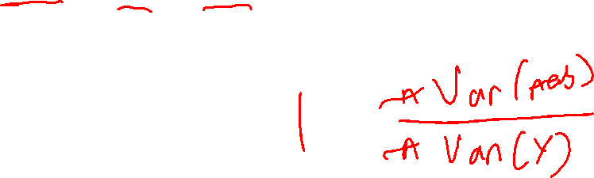
Decomposing
By algebra (see linked PDF), we have:
$${SS}_{total}={SS}_{reg}+{SS}_{resid}$$
What is $R^{2}$?
$$R^{2}=1−\frac{{SS}_{resid}}{{SS}_{total}}=\frac{{SS}_{reg}}{{SS}_{total}}$$
The fraction of variance explained!

Slide 7
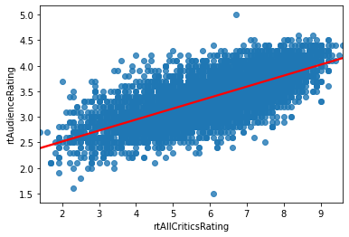
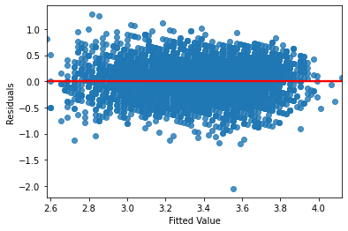
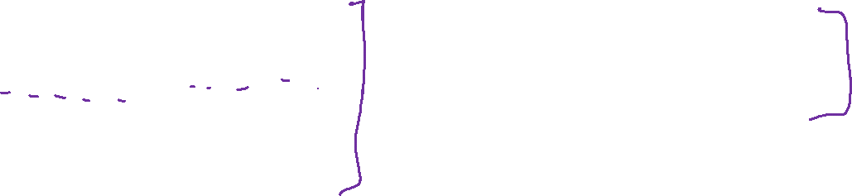
Residual Variance

Slide 8

Wrapping Up
The variance in the outcome variable decomposes into regression variance and residual variance.
R² measures the fraction of total variance explained by the regression.
Photo by Pritesh Sudra on Unsplash

